Slide 1

Ramarao Adik Institute of Technology
Department of Computer Engineering
SE MINI Project 2 - Mock 2 Presentation
On
“Employee Transport Management For Organisations”
By
Roll No
20CE1086
20CE1095
20CE1263
20CE1103
Name of Student
Atharva Hirve
Shabbir Talib
Kewinston Sahaya
Jay Dandekar
Guided by
Tabassum Maktum

Slide 2
Outline
Introduction
Literature Survey of the Existing Systems
Problem Statement
Proposed methodology / Techniques
System Design
Hardware and software requirement
Results and Discussion
Conclusion and Future work
References

Slide 3

Introduction
Create and manage efficient and a well-managed workforce.
Services facilitating faster transport and
efficiency.
Safety and comfort to employees.
Probable financial gains with positive impact
on society.

Slide 4

Introduction
Motivations:
Considering change in work culture, the pandemic being catalyst for change.
Current environment strenuous for the
workforce.
Demerits of traveling and congestion of traffic
experienced.
To develop services that enhance existing ways
of functioning.

Slide 5
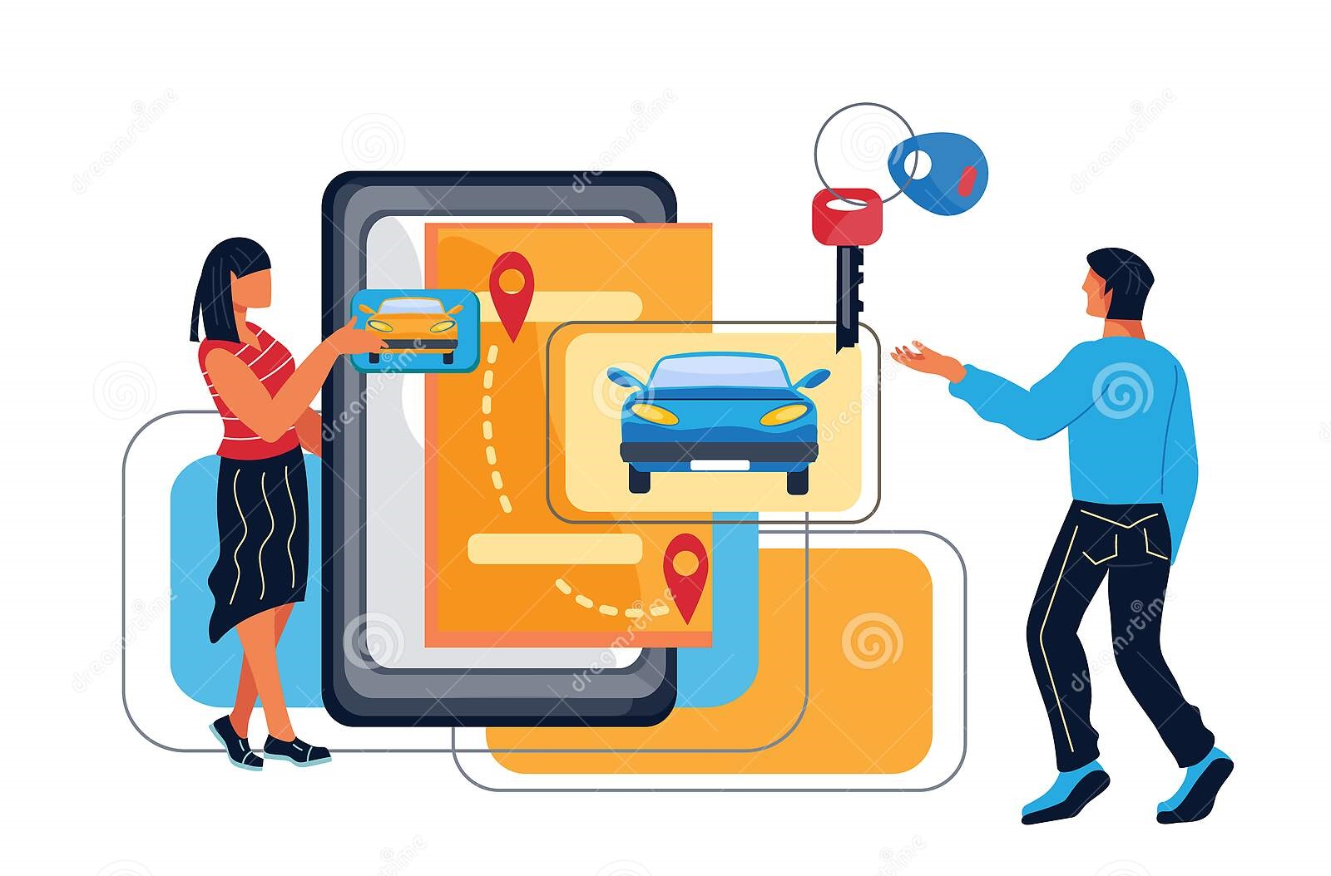
Introduction
Objectives:
To provide transport and pooling service system.
Ensure smooth and safe commute for employees.
Transport pooling system access with Admin.
Organization can overlook the system.
Welfare of employees and rapport-building.

Slide 6
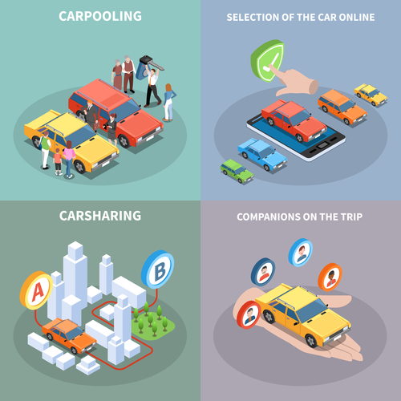
Introduction
Objectives:
Interconnect organization employees and mechanic stations.
More emphasis on high efficiency
Increasing morale through
employee centric systems
Custom made systems to provide
solution to existing issues.

Slide 7

Literature Survey of the existing systems
Pooling services such as Uber Pool developed by the Uber Inc.
Involve booking and utilization of pooling vehicles .
Verification of associated individuals
Changes in fare based on ride
details.

Slide 8




Literature Survey of the existing systems
Some of the companies providing such services are:
Uber POOL
UberX
Lyft
Juno
Gett
Ziro
Wingz

Slide 9


Literature Survey of the existing systems
Observations on the technologies and methodologies :
Provide mapping services with pooling
options.
Advanced features are GPS location
tracking, assistance helpline etc.
Identity masking
Increased and interactive customer support.

Slide 10
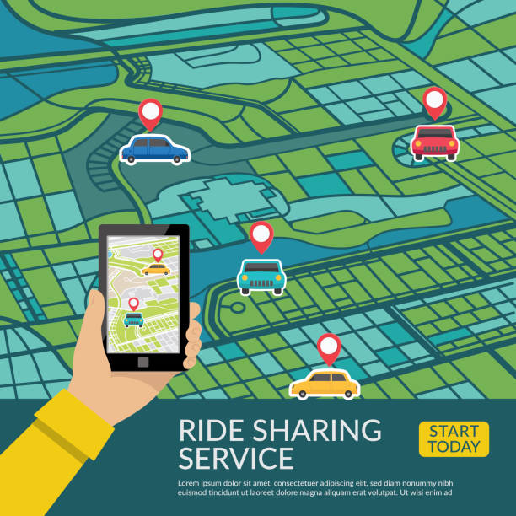
Problem statement
The lack of custom-made, real-time and interactive system specifically designed to cater to the needs of employees.
Absence of association with third parties in an effort to make the system more efficient, safe and reliable.
Proposed solution:
Employees of the same organization to book
slots on routes

Slide 11

Problem statement
Changes from employee or ride
cancellation dealt with using back-up
facilities.
Creation of secure mode of transport with
verified staff.
Assigning female drivers to women
employees.
Mechanic stations for maintenance and repair.
Minimize costs and use of resources.

Slide 12

Problem statement
Features Of Employment Transport System:
1) For Employees:
Trip Details
Routes & Timings
Slots Booking

Slide 13

Problem statement
Features Of Employment Transport System:
2) For Drivers:
Registration and Verification
View Assigned Trips
Pickup &Dropoff Details
Reporting need for maintenance
or repair sessions

Slide 14
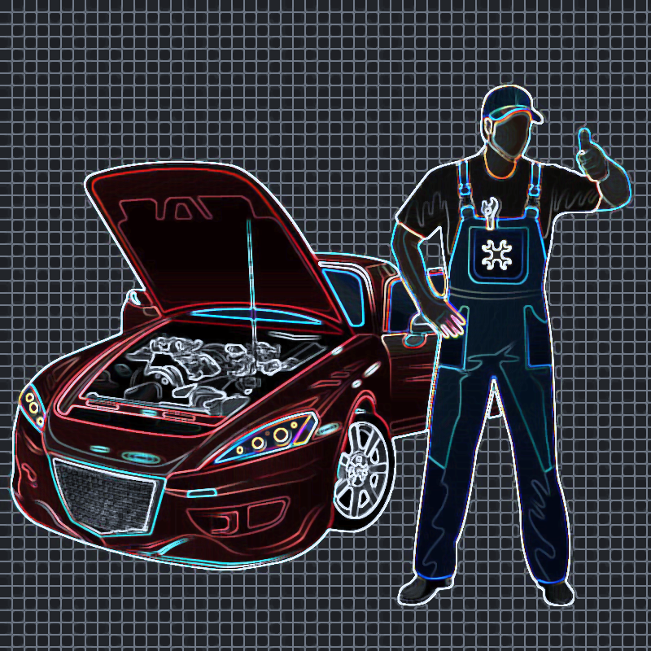
Problem statement
Features Of Employment Transport System:
3) For Mechanic Stations:
Accept Requests for Sessions
Update Slots Availability
Update Vehicle Details

Slide 15

Problem statement
Features Of Employment Transport System:
4) For Admin\Transportation Manager:
Manages Employees & Drivers
& Mechanic Garages
Managing Requests
Managing Routes
Manage Fleet i.e. vehicle details
Manage Rosters i.e. scheduling
for Transportation
Verifying & Confirming Driver's Identity
Session Booking At Mechanic Station

Slide 16
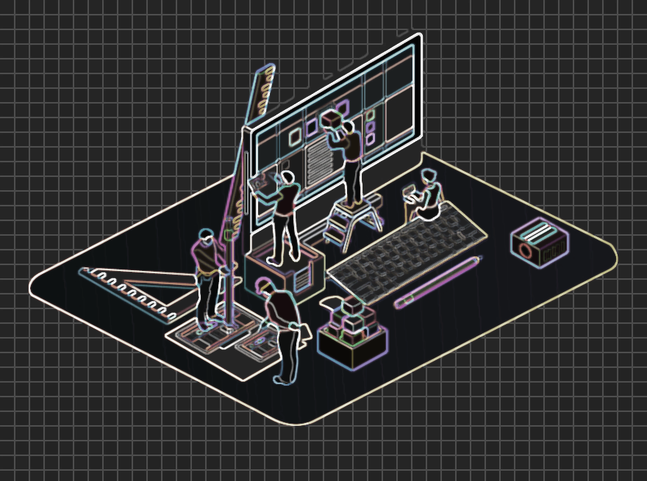
System Design
Database connectivity with backend development.
Frontend development with GUI interfacing
for interactive webpages.
Include dynamic pages and interactive widgets.
Example:
such as feedback button and trip feedback
parameters.

Slide 17
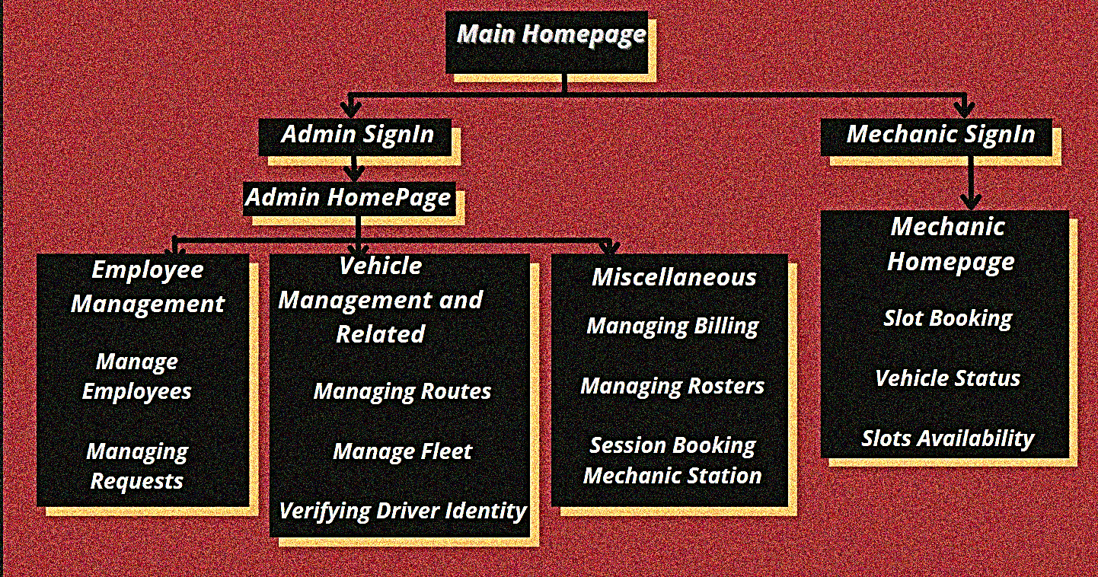
System Design

Slide 18
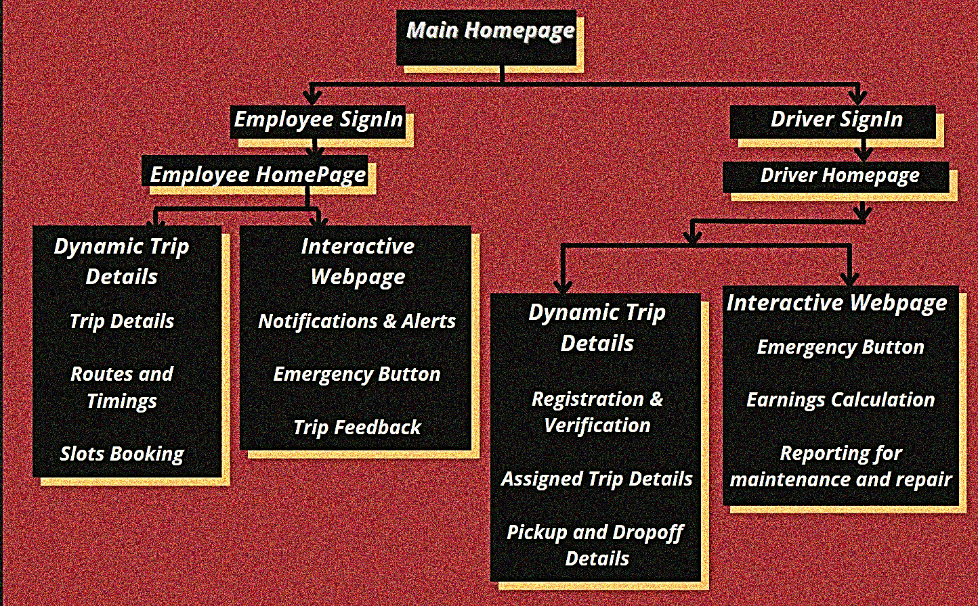
System Design

Slide 19
System Design
DESCRIPTION OF ALGORITHM
STEP 1: Open website homepage.
STEP 2: Access menu and determine your choice(employee, admin, etc.).
STEP 3: Enter user credentials for logging in.
STEP 4: Choose the functionality you want to access and utilise.
STEP 5: Upon performing desired actions and updating information the user can choose to leave by logging out.
STEP 6: For first time users, the option of signing up and verification through the admin is also possible.

Slide 20

Hardware and Software Requirements
Hardware used in the procedure of creating the application:
Microsoft Windows 7/8/10 (32 or 64 bit)
2 GB RAM minimum, 8 GB recommended
2 GB of available disk space minimum, 4 GB recommended
1280 x 800 minimum screen resolution

Slide 21




Hardware and Software Requirements
Software requirement:
HTML
CSS
JavaScript
PHP
XAMPP
MySQL
Bootstrap

Slide 22
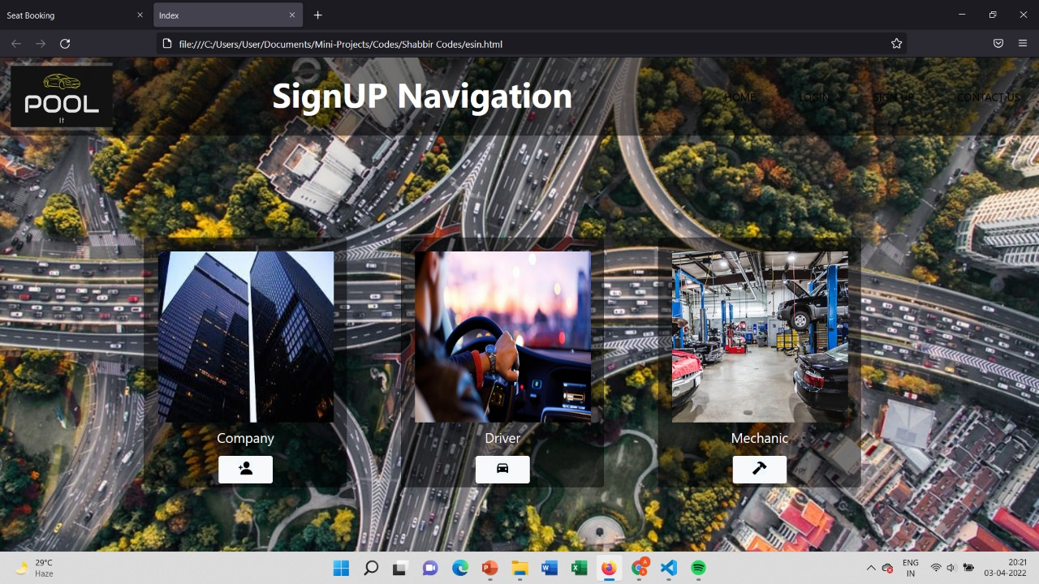
Result And Discussion:
Signup Navigation:

Slide 23
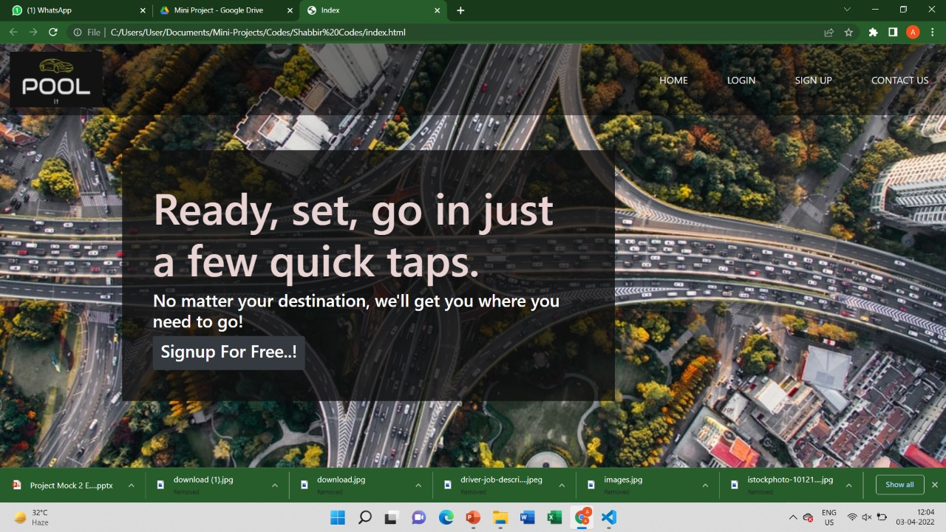
Results and Discussion
Home Page:

Slide 24
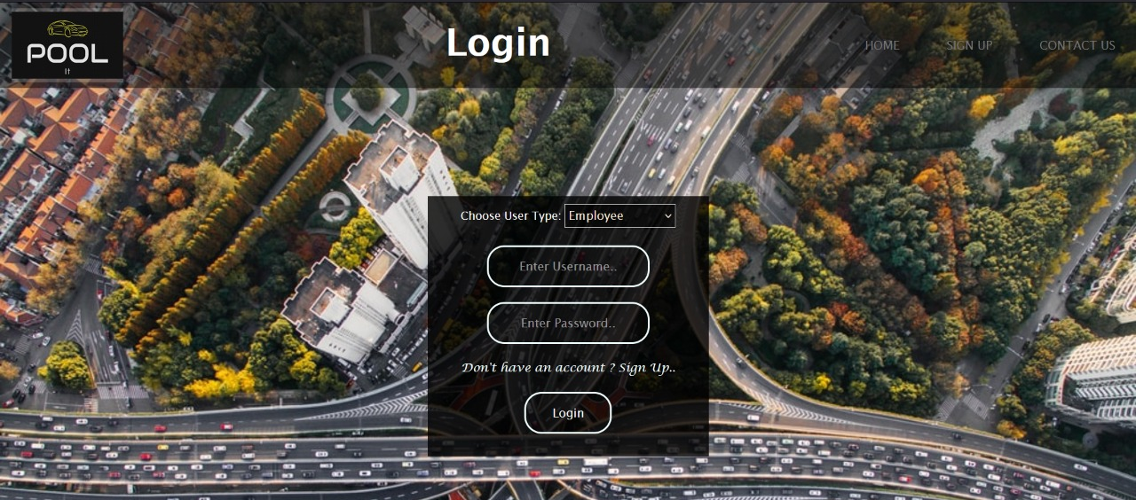
Results and Discussion
Login Page:

Slide 25
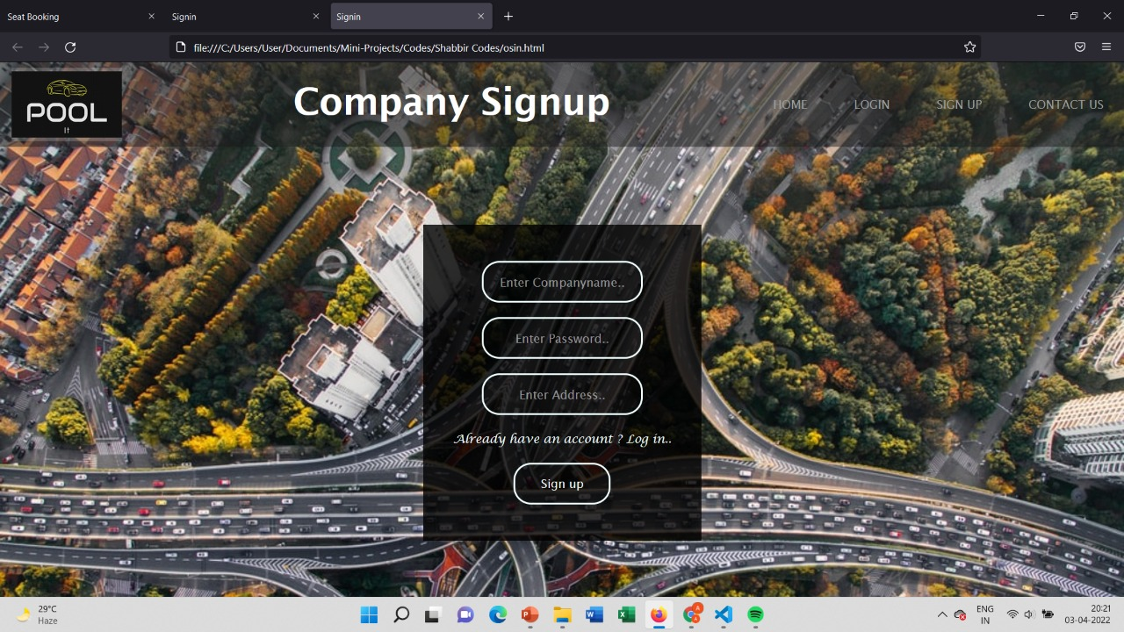
Results and Discussion
Employee Login and Registration:

Slide 26
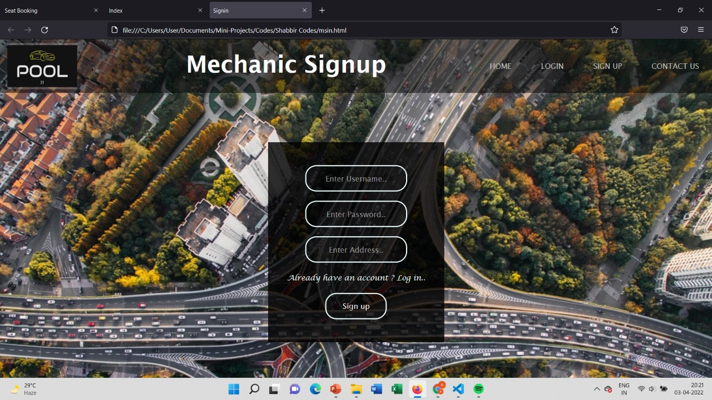
Results and Discussion
Mechanic Login and Registration:

Slide 27
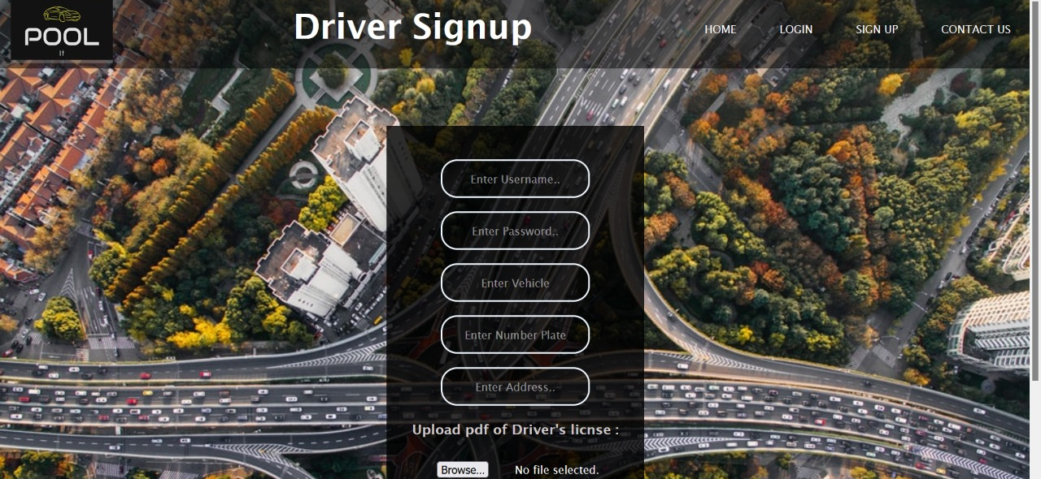
Results and Discussion
Driver Login and Registration:

Slide 28

Conclusion and Future work
This project aims to eliminate problems faced by the employee transportation systems and increase efficiency.
The functionalities in this application
aim to create a system that enforces
restrained and interactive employee
transportation facilities.

Slide 29
References
Citations:
Carpool – Wikipedia
List Of Ridesharing Companies | Ridester.com
What Are The Benefits Of Carpooling? - Poola.app
Liftango | What is Carpooling?
Sharing Economy: What is Ridesharing? (gcfglobal.org)
Gig 101: What Is Ridesharing? How Does Lyft And Uber Work? - Courier Hacker

Slide 30
References
Literature Survey Reference:
Integrating public transport and car-pooling services: Evidence from a field test in Switzerland
April 2020
Conference: Transport Research Arena 2020
At: Helsinki, Finland
Volume: https://www.traficom.fi/sites/default/files/media/publication/TRA2020-Book-of-Abstract-Traficom-research-publication.pdf
Transport Pooling: Moving Toward Green Distribution
December 2019
DOI:10.1002/9781119686750.ch3
In book: Solving Transport Problems (pp.63-95)
Project: Sustainable transportation and distribution

Slide 31
References
Papers referenced along with authors:
Integrating public transport and car-pooling services: Evidence from a field test in Switzerland
Authors:
Francesca Cellina University of Applied Sciences and Arts of Southern Switzerland
Marco Derboni Dalle Molle Institute for Artificial Intelligence
Nikolett Kovacs University of Applied Sciences and Arts of Southern Switzerland
Andrea-Emilio Rizzoli University of Applied Sciences and Arts
Transport Pooling: Moving Toward Green Distribution
Authors:
Alaeddine ZouariI Institute Supérieur de Gestion Industrielle

Slide 32
Thank You

